Slide 1
INTRODUCTION TO COMPUTING
Course Code: CCINCOM/L
Expression Trees
Joseph Marvin R. Imperial
Faculty
Department of Computer Science
College of Computing and Information Technologies (CCIT)
National University
Joseph Marvin R. Imperial
DATA STRUCTURES AND ALGORITHMS
NU College of Computing and Information Technologies
Course Code: CCDATRCL

Slide 2
Binary expression tree
A binary expression tree is a specific kind of a binary tree used to represent expressions.
Two common types of expressions that a binary expression tree can represent are algebraic and Boolean. These trees can represent expressions that contain both unary and binary operators.
Each node of a binary tree, and hence of a binary expression tree, has zero, one, or two children. This restricted structure simplifies the processing of expression trees.
Joseph Marvin R. Imperial
DATA STRUCTURES AND ALGORITHMS
NU College of Computing and Information Technologies
Course Code: CCDATRCL

Slide 3
Representation through binary trees
The leaves of a binary expression tree are operands, such as constants or variable names, and the other nodes contain operators.
These particular trees happen to be binary, because all of the operations are binary.
Joseph Marvin R. Imperial
DATA STRUCTURES AND ALGORITHMS
NU College of Computing and Information Technologies
Course Code: CCDATRCL

Slide 4
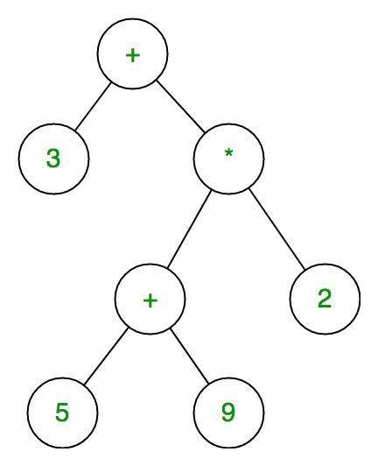
Sample
Joseph Marvin R. Imperial
DATA STRUCTURES AND ALGORITHMS
NU College of Computing and Information Technologies
Course Code: CCDATRCL

Slide 5
Traversal
An algebraic expression can be produced from a binary expression tree by recursively producing a parenthesized left expression, then printing out the operator at the root, and finally recursively producing a parenthesized right expression.
This general strategy (left, node, right) is known as an in-order traversal.
Pre-order and post-order traversal can also be used in some cases, if specified.
Joseph Marvin R. Imperial
DATA STRUCTURES AND ALGORITHMS
NU College of Computing and Information Technologies
Course Code: CCDATRCL

Slide 6
Traversal
in-order = infix
pre-order = prefix
post-order = postfix
Joseph Marvin R. Imperial
DATA STRUCTURES AND ALGORITHMS
NU College of Computing and Information Technologies
Course Code: CCDATRCL

Slide 7
Infix traversal
When an infix expression is printed, an opening and closing parenthesis must be added at the beginning and ending of each expression.
As every subtree represents a subexpression, an opening parenthesis is printed at its start and the closing parenthesis is printed after processing all of its children.
Joseph Marvin R. Imperial
DATA STRUCTURES AND ALGORITHMS
NU College of Computing and Information Technologies
Course Code: CCDATRCL

Slide 8
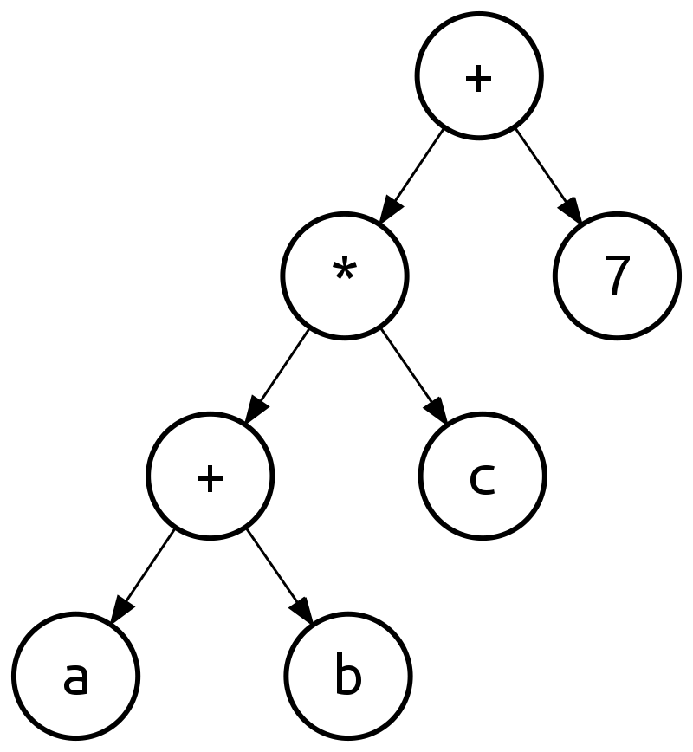
Infix traversal
Joseph Marvin R. Imperial
DATA STRUCTURES AND ALGORITHMS
NU College of Computing and Information Technologies
Course Code: CCDATRCL

Slide 9
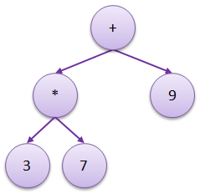
Guess the algebraic expression (infix)
Joseph Marvin R. Imperial
DATA STRUCTURES AND ALGORITHMS
NU College of Computing and Information Technologies
Course Code: CCDATRCL

Slide 10
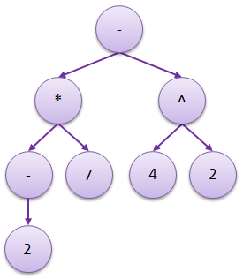
Guess the algebraic expression (infix)
Joseph Marvin R. Imperial
DATA STRUCTURES AND ALGORITHMS
NU College of Computing and Information Technologies
Course Code: CCDATRCL

Slide 11
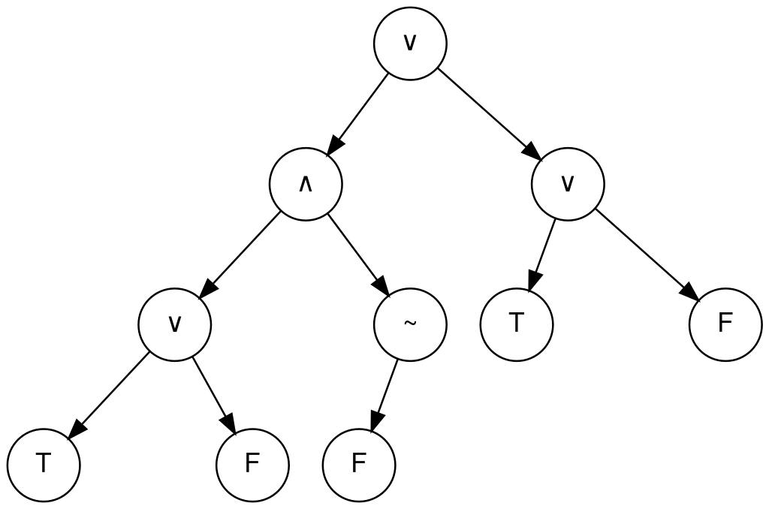
Guess the algebraic expression (infix)
Joseph Marvin R. Imperial
DATA STRUCTURES AND ALGORITHMS
NU College of Computing and Information Technologies
Course Code: CCDATRCL

Slide 12
Construct the expression tree:
(3 + 2)^3 / (46 - 12)
(5 * 4) + 8
11 * (22 + 8.6)
Joseph Marvin R. Imperial
DATA STRUCTURES AND ALGORITHMS
NU College of Computing and Information Technologies
Course Code: CCDATRCL

Slide 13
References
https://en.wikipedia.org/wiki/Binary_expression_tree
https://www.101computing.net/binary-expression-trees/
Joseph Marvin R. Imperial
DATA STRUCTURES AND ALGORITHMS
NU College of Computing and Information Technologies
Course Code: CCDATRCL

